Slide 1
Steps For Candidate
Registration Process on Skill India Digital Portal

Slide 2
Registration in 3 Stages
Stage 1
Stage 2
Stage 3

Slide 3
Stage 1

Slide 4
Eligibility Criteria
You should have paid fee on ERP to make yourself eligible to register on NSDC.
You must use Adhaar Linked Mobile Number only for registration.
Wherever asked you should only use KL Domain Mail ID.
Do the registration after taking permission from the course instructor.
Note: If you are failing to do so, even though you register on the portal, you won’t be getting the certificate.

Slide 5
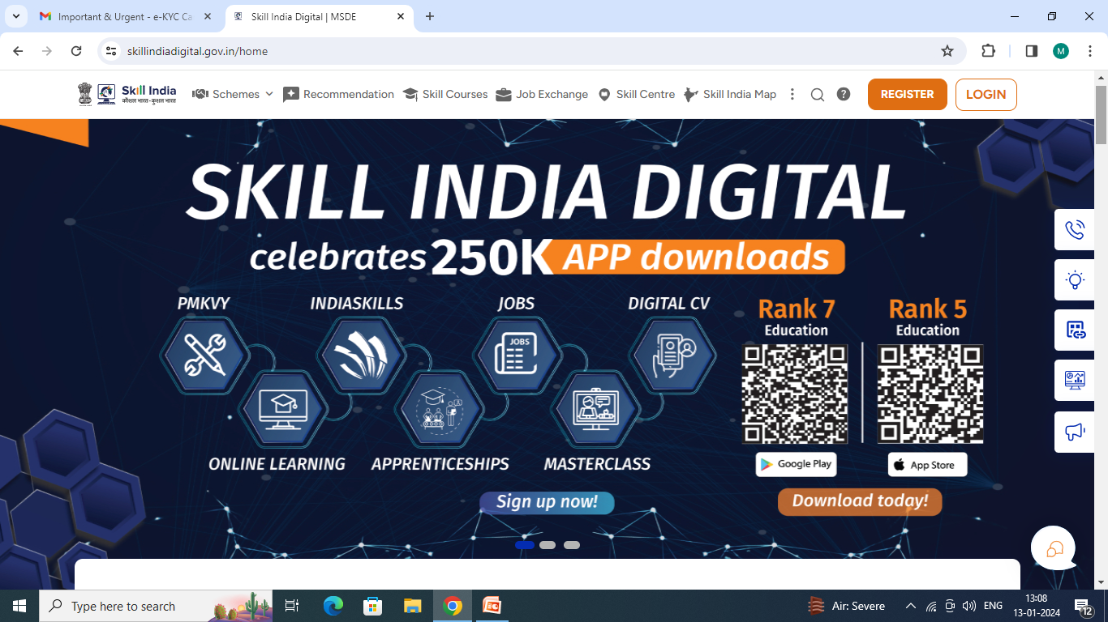
Step 1:- Type The Skill India Digital.gov.in in Your Browser (https://www.skillindiadigital.gov.in/)

Slide 6
Step 2:- Click On Register Button in the top Right Corner

Slide 7
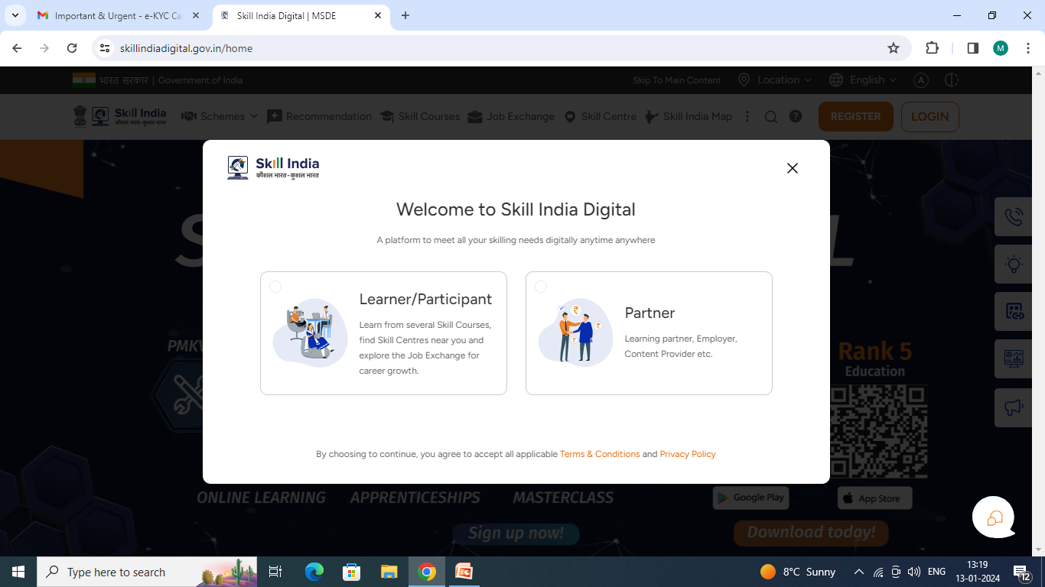
Step 3:- Click on Learner/ Participant Box

Slide 8
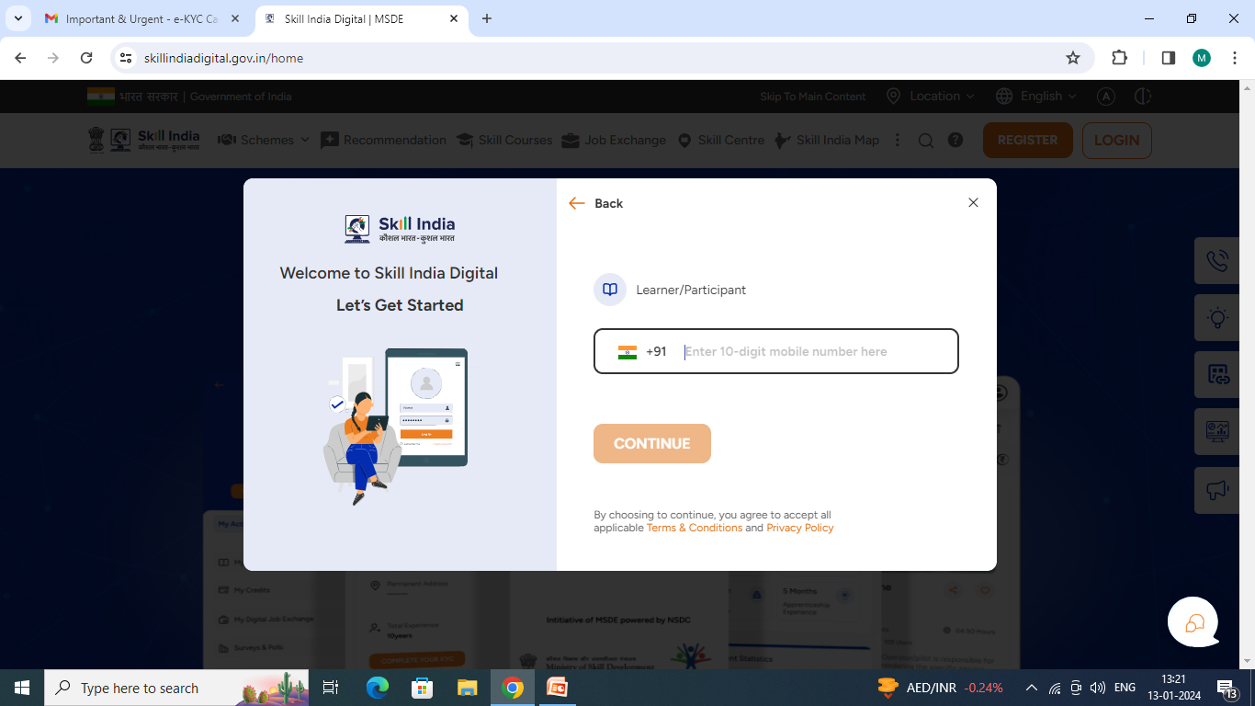
Step 4:- Type the 10 Digits Learner Mobile Number in this box (Use Adhaar Linked Mobile Number only)

Slide 9
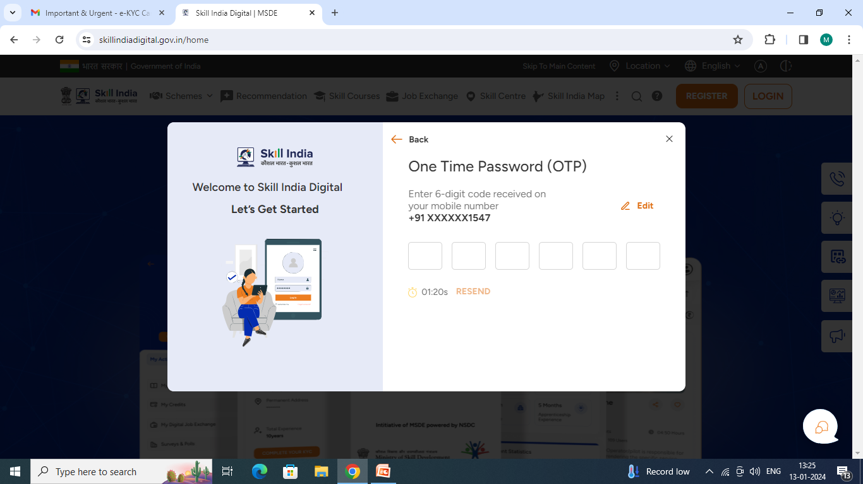
Step 5:- 6 Digits OTP entered into Box

Slide 10
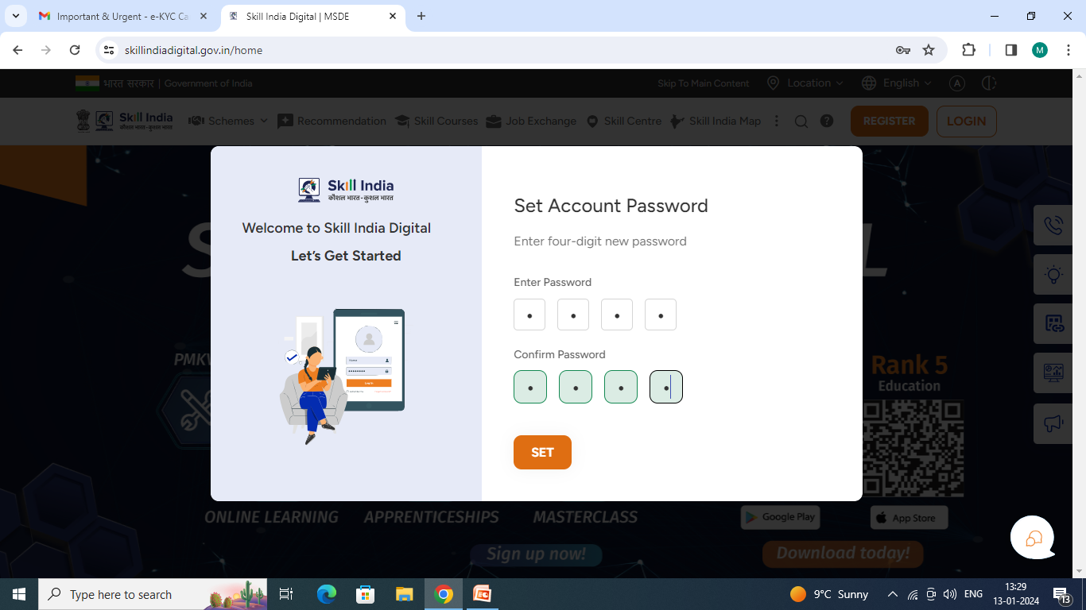
Step 6:- Set the 4 Digits Candidate Account Password

Slide 11
Step 7:- Click on Set Button
It will set the pin automatically, refresh the page and go back to login and with the mobile number enter pin and fresh otp

Slide 12
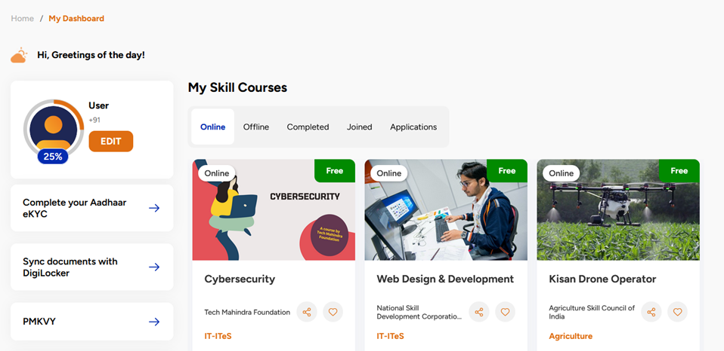
Step 8:- Click on Complete your Aadhaar eKYC

Slide 13
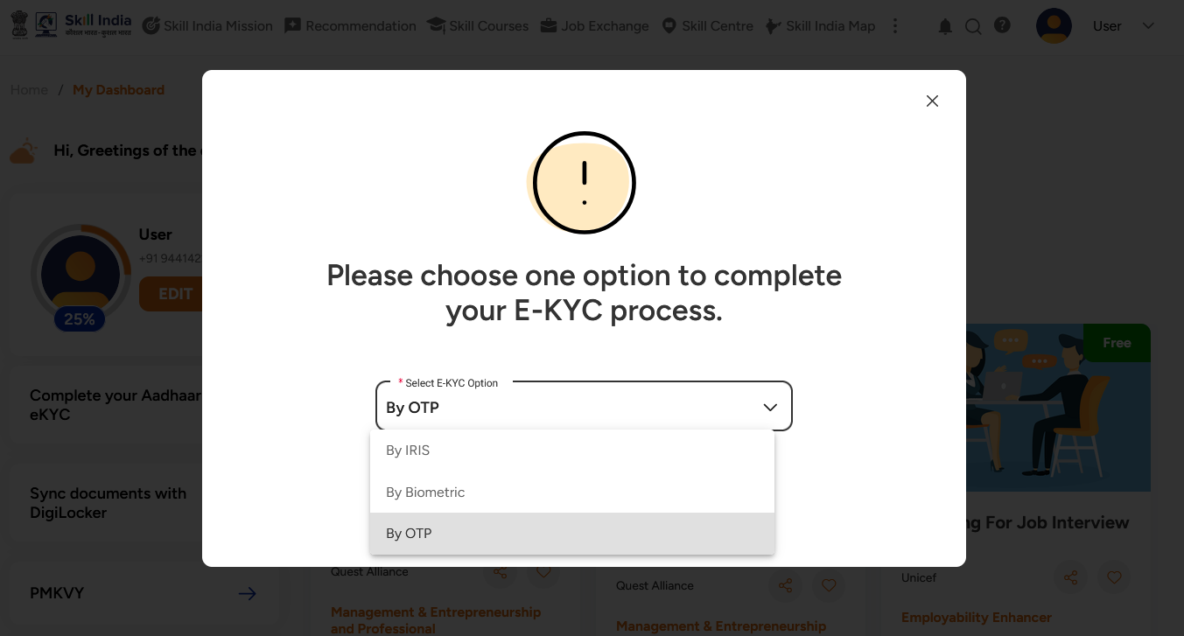
Step 9:- Click on By OTP

Slide 14
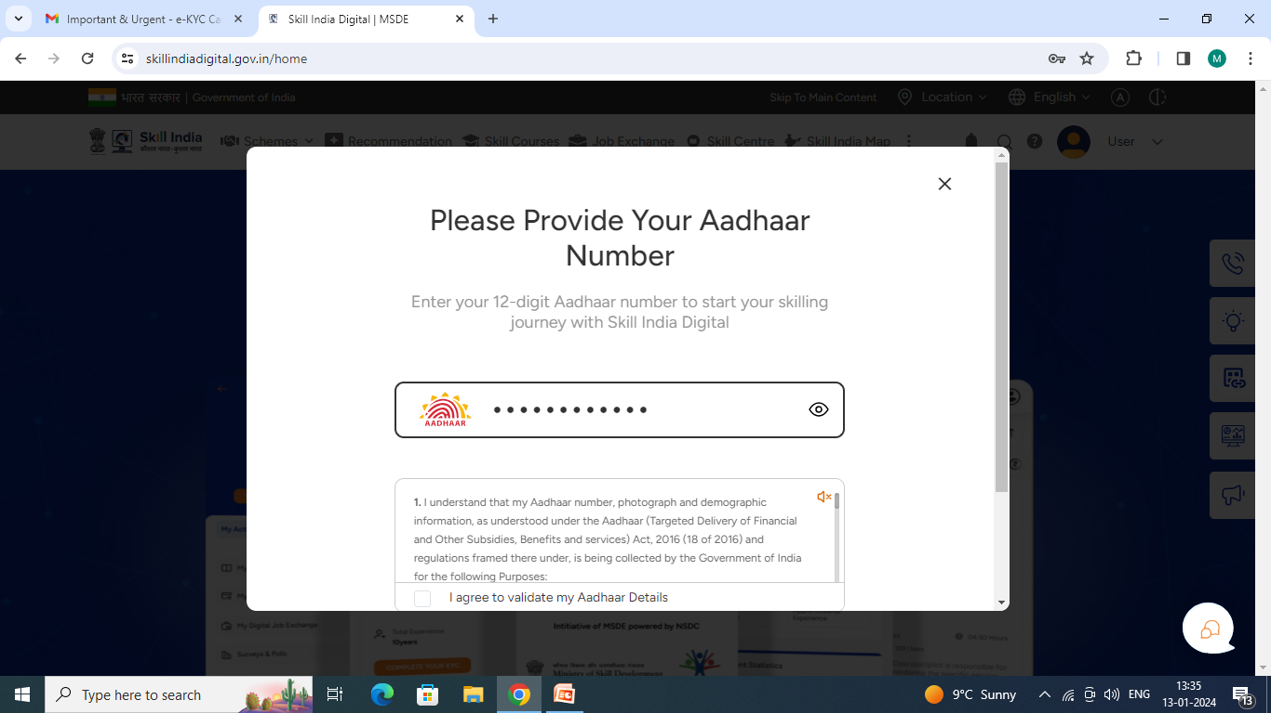
Step 10:- Entered The 12-Digits Candidate Aadhar Number For e-kyc Process

Slide 15
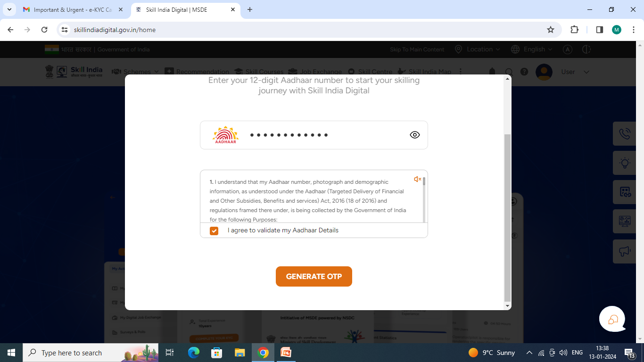
Step 11:- Click on Check Box and Click on GENERATE OTP box

Slide 16
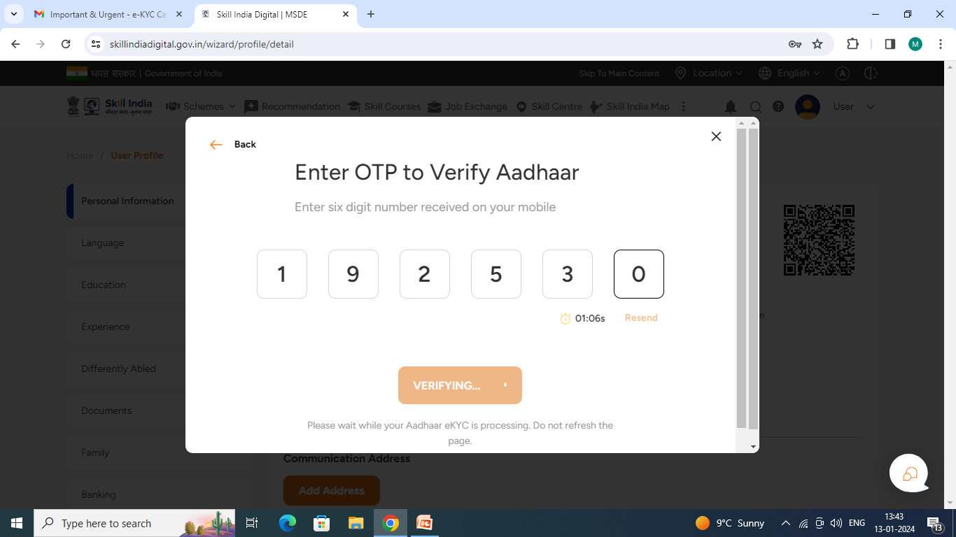
Step 12:- OTP will be send to Aadhar Linked Mobile No and entered 6-Digits Mobile Number

Slide 17
Log Out and Login

Slide 18
Candidate Login Process
Step 13:- Click on LOGIN Button

Slide 19
Step 14:- Click on Learner/ Participant Box

Slide 20
Step 15:- Type the 10-digits Learner Mobile No and click Continue Button

Slide 21
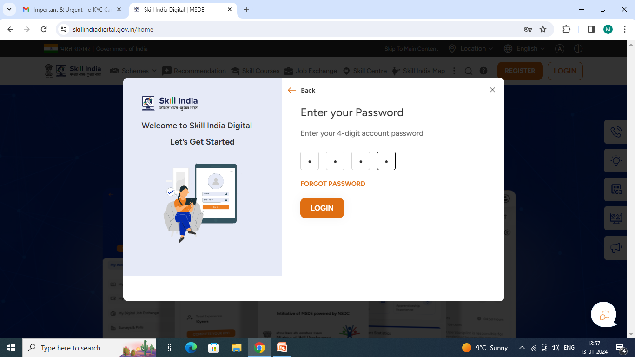
Step 16:- Enter your 4-digits password and click Login

Slide 22
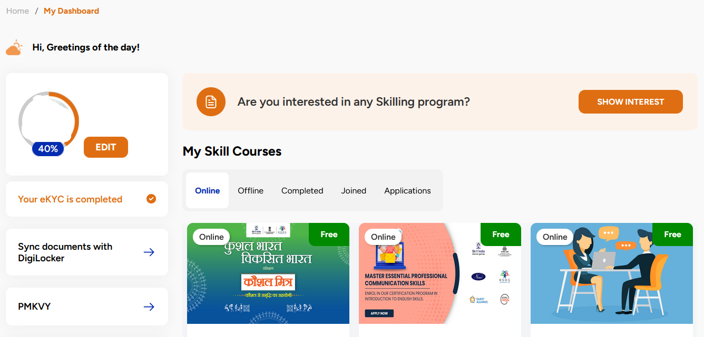
Step 17:- Click on SHOW INTEREST

Slide 23
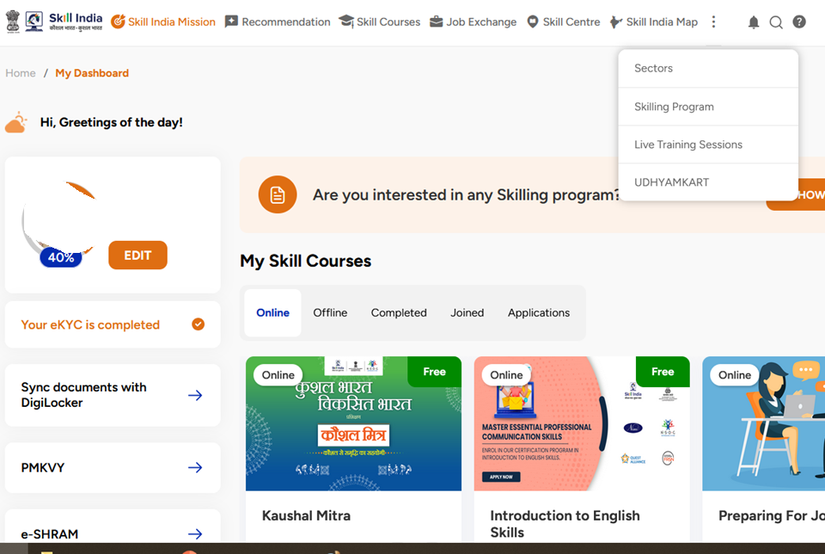
Step 18: Click on three vertical dots and select Skilling Program

Slide 24
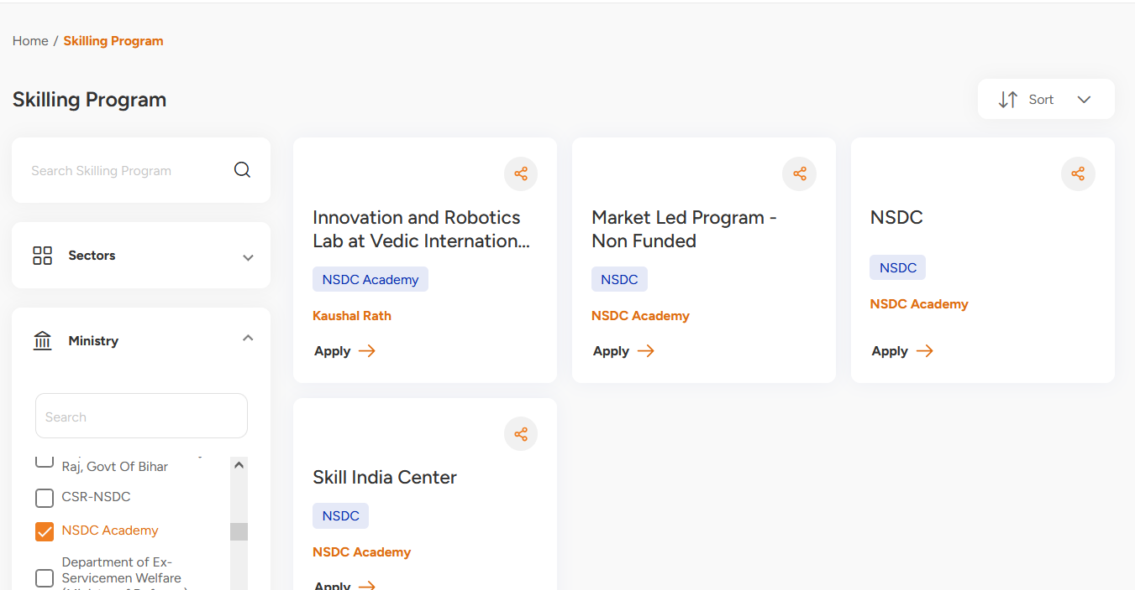
Step 19: Under Ministry Select NSDC Academy and Click Apply on Market Led Program – Non Funded

Slide 25
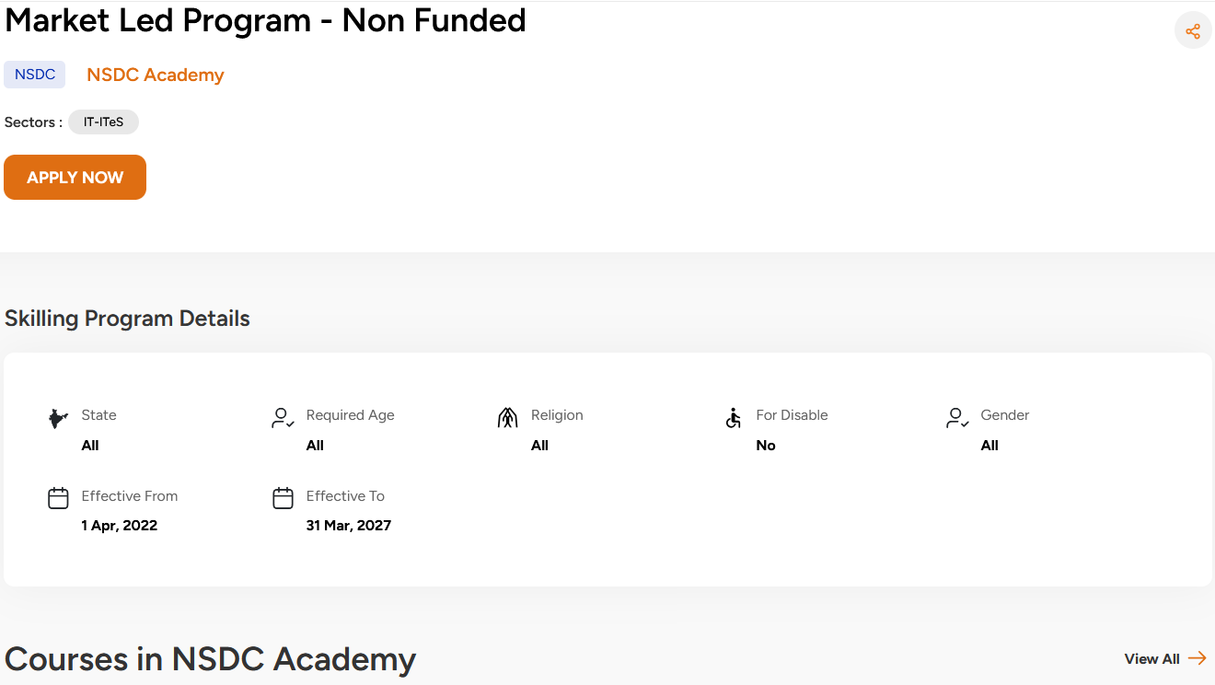
Step 20: Click on View All at the right Bottom

Slide 26
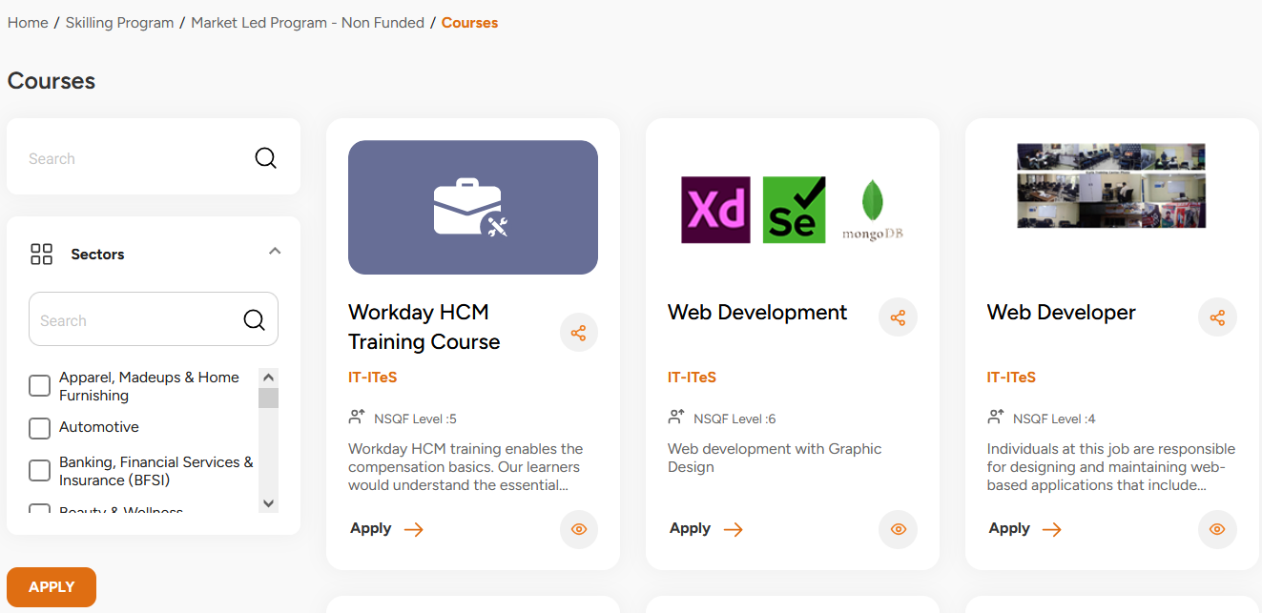
Step 21: Search for your course (List of courses given in the next slide)

Slide 27
List of Courses offered (Search With Exact Course Name)
Course Name
AWS Certified Solutions Architect - Associate
AWS Cloud Practitioner
Certified Ethical Hacker
GOOGLE CLOUD PROFESSIONAL DATA ENGINEER
GOOGLE CLOUD ASSOCIATE CLOUD ENGINEER (GCP-ACE)
Juniper Networks Certified Associate Junos (JNCIA-Junos)
MICROSOFT CERTIFIED: AZURE AI FUNDAMENTALS (AI-900)
MICROSOFT CERTIFIED: AZURE FUNDAMENTALS (AZ-900)
Palo Alto Networks Certified Cybersecurity Entry-level Technician (PCCET)
PCAP: Programming Essentials in Python
Red Hat Certified Enterprise Application Developer
ServiceNow - Certified System Administrator

Slide 28
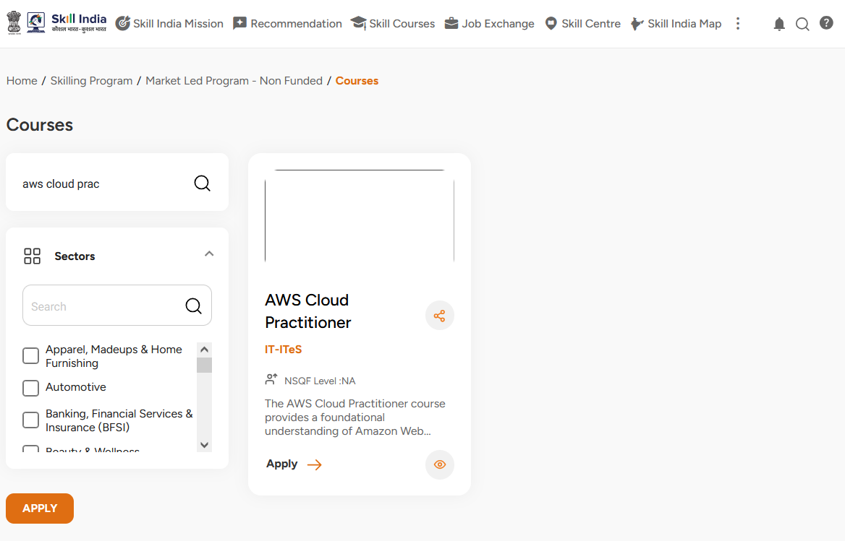
Step 22: Click on Apply after searching for the course

Slide 29
Each Course has different batches mapped to faculty
Please contact your assigned faculty to know their Batch ID

Slide 30
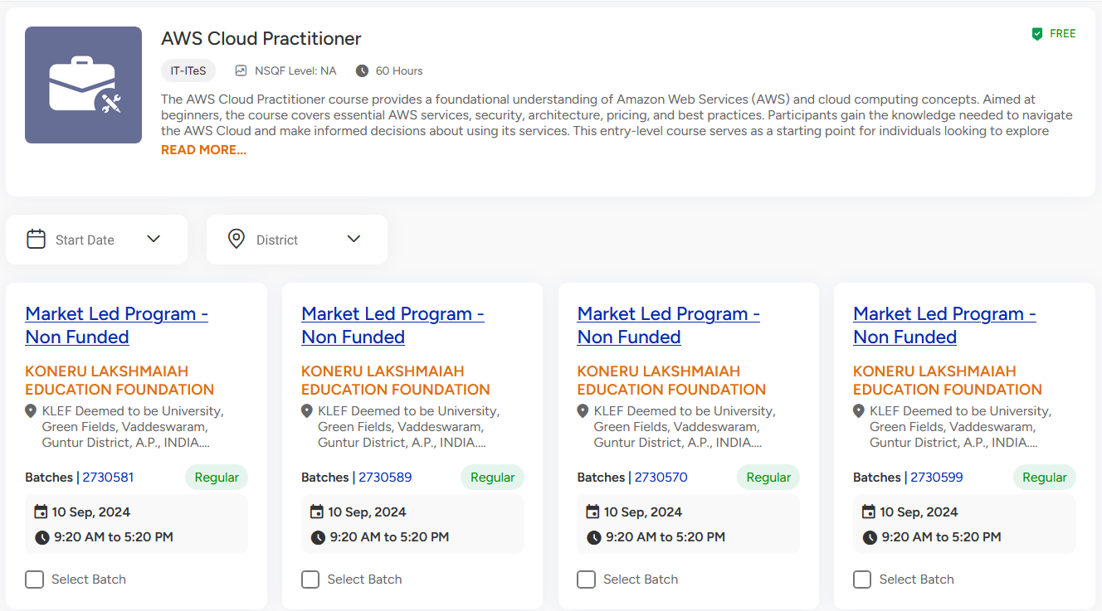
Step 23: List of Batches will appear, Select a batch number that will be informed by your course instructor. (Each course instructor will be having unique batch ID. If you select wrong batch ID you won't get certificate.)

Slide 31
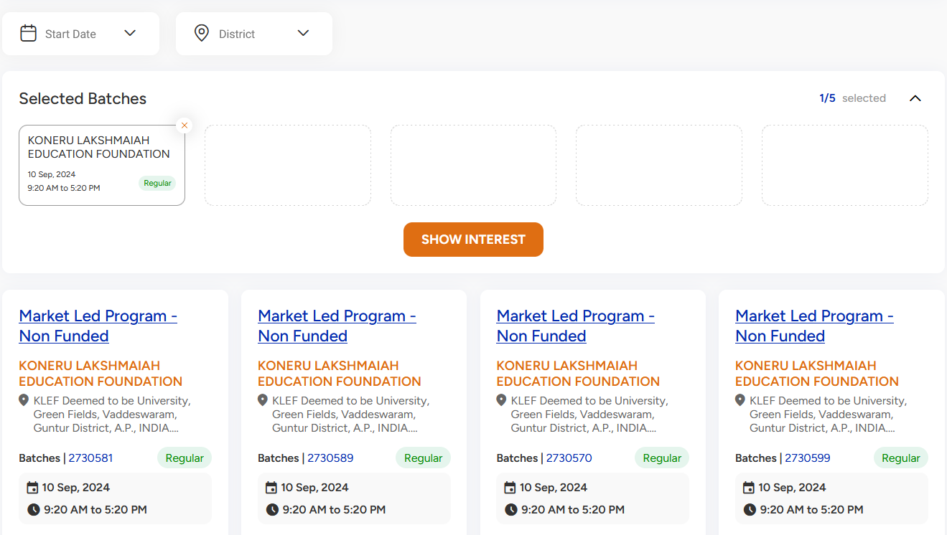
Step 24: Click on Show Interest after selecting the batch (you should select only one batch. Showing interest in multiple batches is not permitted. If you do so your registration will be cancelled)

Slide 32
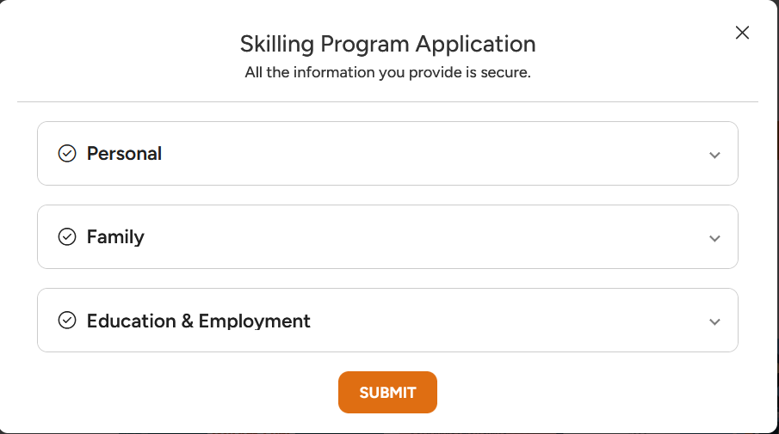
Step 25:- Enter all the needed information, Use KL domain mail id only (@kluniversity.in)

Slide 33
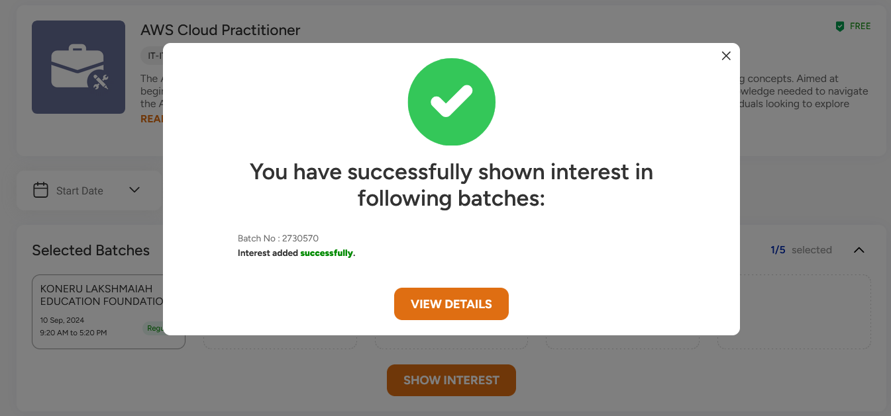
Step 26:- You will get this pop-up window after successful entries

Slide 34
Stage 2

Slide 35
Informing Certification Course Faculty
Inform Certification Course Assigned faculty that you have submitted your interest to the course with Course name and Batch ID
By 1 PM, mostly your application will be approved. Then you can move to Stage 3.
If application is still pending, inform your assigned faculty.

Slide 36
Stage 3

Slide 37
Step 1:- Again Visit on Skill india Digital Portal and Follow Candidate Login Process

Slide 38
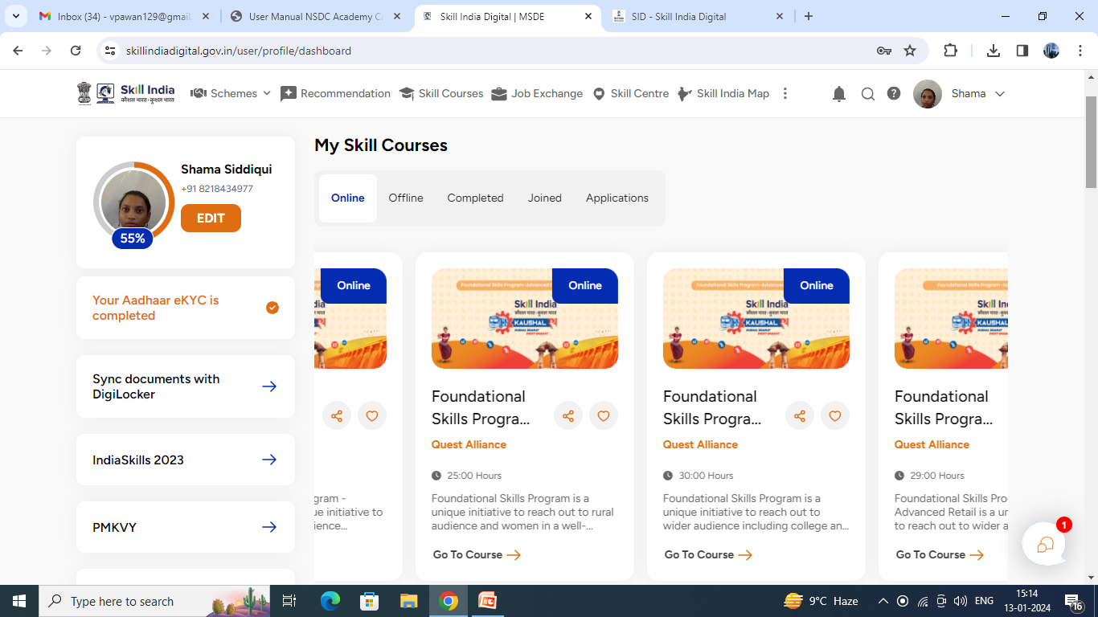
Step 2:- Click on Pop down menu on your profile and click on Dashboard
Click on Applications

Slide 39
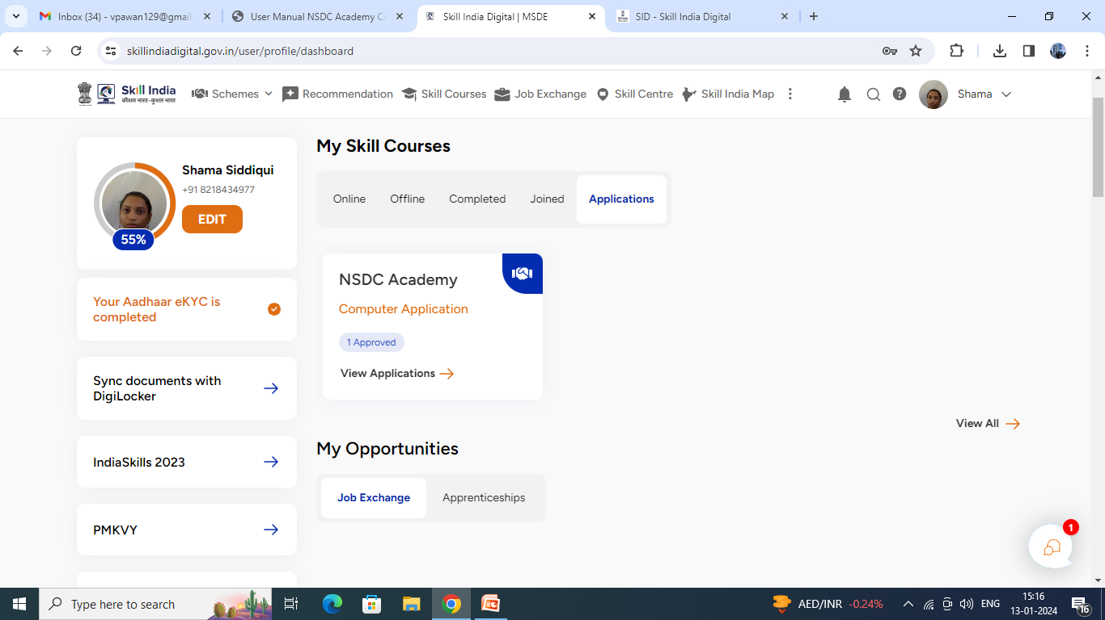
Step 3:- Click on View Applications

Slide 40
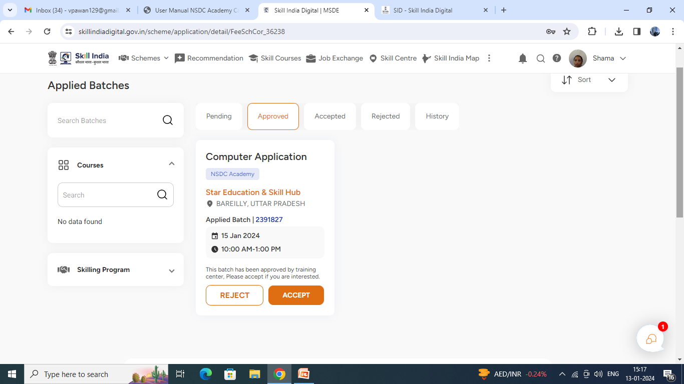
Step 4:- Click on Approved and Click on Accept Button
If it is still pending wait for 1 more hour and check regularly. Once it is approved, you can Click on Accept. If you don’t click on Accept, you won’t get registered. So its important to click on Accept.

Slide 41
Your Registration is Successful
Happy Learning

